Slide 1
North Atlantic Coast
Comprehensive Study
Exposure Assessment Desktop Exercise
U.S. Army Corps of Engineers
Coastal Storm Risk Management
Planning Center of Expertise
25 September 2013

Slide 2
Working Definitions
  Resiliency – The ability to avoid, minimize, withstand, and recover from the effects of adversity, whether natural or manmade, under all circumstances of use – applies to engineering, ecological, and communities
  Redundancy – Redundancy is the duplication of critical components of a system with the intention of increasing reliability of the system, usually in the case of a backup or fail-safe
  Robustness – Robustness is the ability of a system to continue to operate correctly across a wide range of operational conditions with minimal damage, alteration or loss of functionality, and to fail gracefully outside of that range
Risk – The risk of a coastal storm event is its probability of occurrence multiplied by the consequences. The consequences are measured in terms of life safety and property/asset damages
Vulnerability – a function of the character and magnitude to which a system is exposed, the sensitivity of the system, and the system’s adaptive capacity
  Exposure – the nature and magnitude of the hazards that threaten the system
  Sensitivity – the potential of system’s valued functions to be affected by the changes caused by a hazard
  Adaptation – Adaptive capacity, adaptive management, climate change adaptations

Slide 3
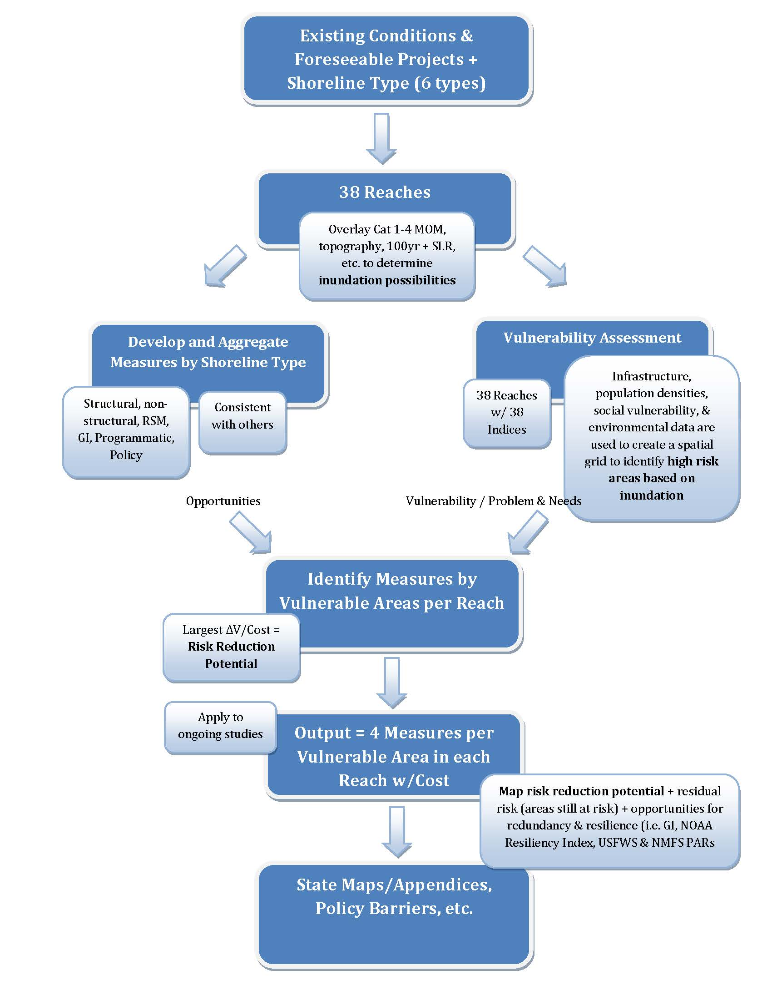
Plan Formulation and GIS Process

Slide 4

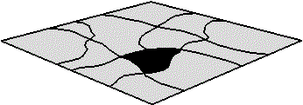

Creation Steps of the Independent Exposure Indices
1
10
5
5.0
1
5
1.8
6.6
4.2
10
10
7.0
1
5
10
Input Data Layers
Weighted Input
Data Layers
Risk Index Layer

Slide 5









Creation Steps of the Composite
Exposure Index
Environmental
Risk Index
10%
6.6
5.0
4.2
1.8
10
7.0
Infrastructure
Risk Index
80%
Composite Risk Index
Social Vulnerability
Risk Index
10%

Slide 6
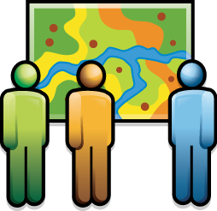

Problem Areas Identification
5.0
1.8
6.6
4.2
10
7.0
Composite Risk Index
Apply Minimum Risk Threshold
Regional Area Expert Problem Identification Verification
NACCS
Problem Area
Locations
(USACE, Other Federal Agencies, and State Agencies)

Slide 7
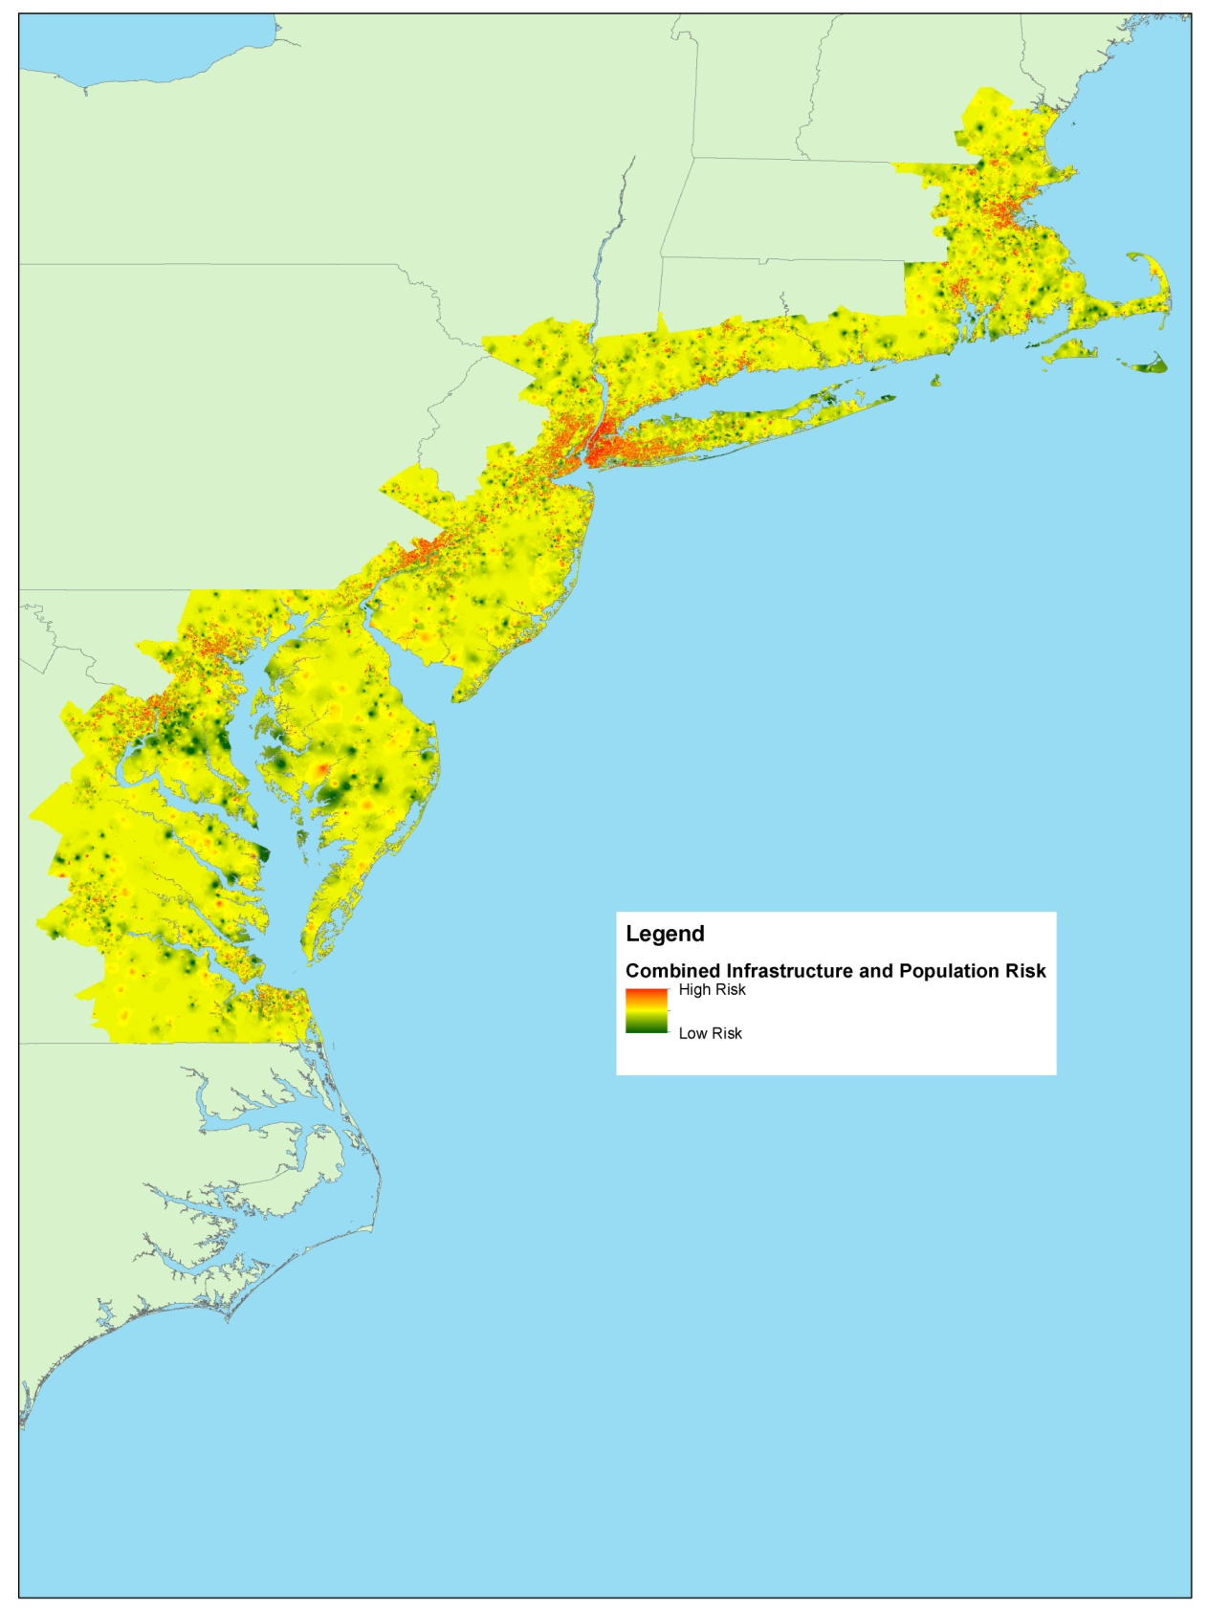
Plan Formulation and GIS Process
Exposure Assessment
*Infrastructure + Population Index
*Social Index
-2010 Census (tract level)
-% Population 65 and over
-% Population under 5
-% Population w/income below poverty
-% Population non-proficient English speakers
-Index of income inequality
*Environmental Index
*Combined (composite)

Slide 8
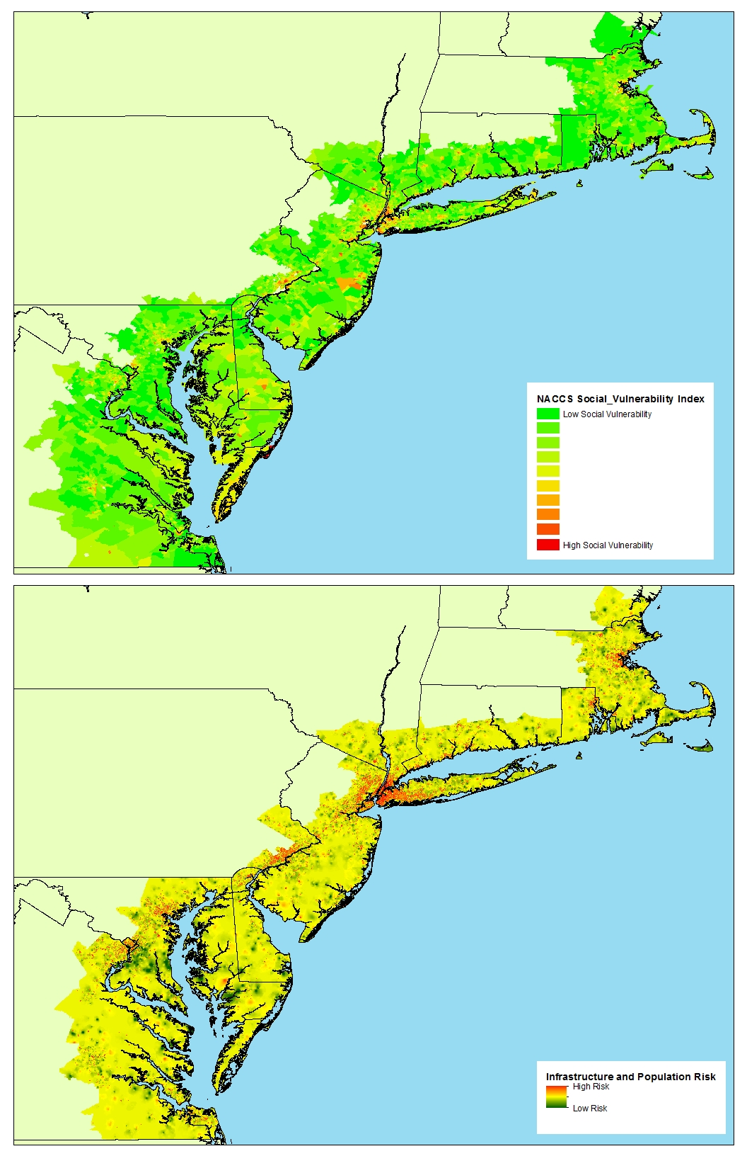
Plan Formulation and GIS Process

Slide 9
Sea Level Change Background
Intergovernmental Panel on Climate Change predicts continued or accelerated global warming, which will cause continued or accelerated rise in global mean sea-level
Climate-driven global mean sea level change (SLC) scenarios have been developed by USACE (2011) and NOAA (2012)
These scenarios are suitable for use in assessing the future impacts of sea level change on the natural environment and human infrastructure
The application of these SLC scenarios for the North Atlantic Coast Comprehensive Study (NACCS) is outlined in this presentation
USACE 2011: Sea-Level Change Considerations for Civil Works Programs
NOAA 2012: Global Sea Level Rise Scenarios for the United States National Climate Assessment
Notes:
Recent climate research by the Intergovernmental Panel on Climate Change (IPCC) predicts continued or accelerated global warming for the 21st Century and possibly beyond, which will cause a continued or accelerated rise in global mean sea-level.
Climate-driven global mean sea level change (SLC) scenarios have been developed by USACE (2011) and NOAA (2012)
These scenarios are suitable for use in assessing the future impacts of sea level change on the natural environment and human infrastructure.
The application of these SLC scenarios for the North Atlantic Coast Comprehensive Study (NACCS) is outlined below.

Slide 10
Global vs. Local Sea Level Change
During the 20th century global mean sea level rise stabilized to approximately 1.7mm/yr (IPCC 2007)
Local Relative Sea Level Change (RSLC) is influenced by decadal-scale climate and oceanographic patterns
These patterns may influence sea level on a temporary (decadal or shorter) basis, but these fluctuations are NOT associated with long-term sea level change patterns
RSLC relies on long-term water level records > 30 years to remove non-GMSL sea level fluctuations and capture local/regional land uplift and subsidence
IPCC 2007. Climate Change 2007: The Physical Science Basis. Contribution of Working Group I to the Fourth Assessment Report of the Intergovernmental Panel on Climate Change
Notes:
The current rate for global sea level rise over the past several thousand years has been due to the inter-glacial warming period which followed the last ice age. This has caused the GSML rise to stabilize at an approximate rate of 1.7mm/yr during the twentieth century (IPCC 2007).

Slide 11
Site-Specific Future Sea Level Change
RSLC is the sum of global mean sea level change and regional/local vertical land subsidence/uplift
Relative sea level change (RSLC) is required to assess sea level change impacts at specific sites
RSLC has been measured directly by NOAA long term water level gages
35 NOAA water level gage sites from VA to MA were evaluated for NACCS

Slide 12
NACCS SLR Scenarios
USACE 2011: Sea-Level Change Considerations for Civil Works Programs
NOAA 2012: Global Sea Level Rise Scenarios for the United States National Climate Assessment
Notes:
The current USACE guidance on development of relative sea level change (USACE 2011) outlines the development of three scenarios: Low, Intermediate and High, shown here in Green, Yellow and Orange, respectively. The Low scenario is an extrapolation of the historical measurements of local sea level change at the relevant local tide gauge stations; this is the ‘baseline’ estimate of future sea levels if global sea level rise does not accelerate but continues to rise at the historical rate. The Intermediate and High scenarios are based on the historical baseline rate, but add an acceleration factor corresponding to rates developed by the National Research Council (NRC 1987). The Intermediate scenario corresponds to the NRC ‘Curve I’ and the High scenario to the NRC ‘Curve III’. All three of these USACE SLC scenarios are applied in the NACCS.
NOAA published a report in 2012 that outlines four sea level change scenarios; Low, Intermediate Low, Intermediate High and Highest (NOAA 2012). The first three scenarios are similar in magnitude to the three USACE scenarios. The NOAA Highest scenario predicts sea level rises that are higher than the USACE High estimate. In order to span the full range of existing Federal guidance on sea level change, the NOAA Highest scenario is also used in the NACCS.
An example of the four relative sea level change scenarios is shown for Sandy Hook, N.J.

Slide 13
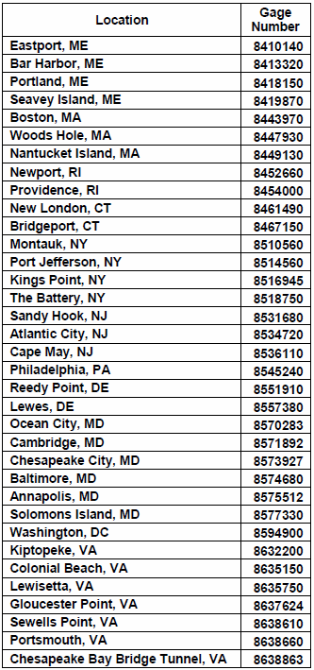
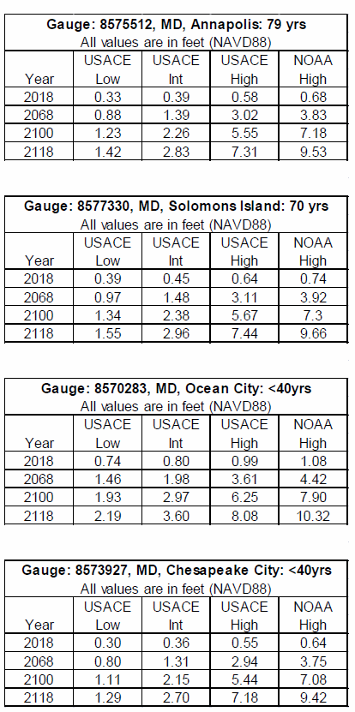
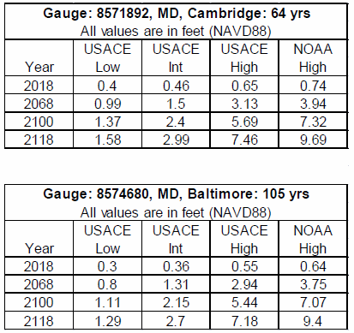
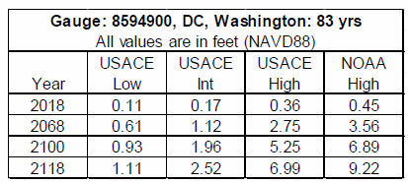
Sea Level Rise Mapping

Slide 14

Sea Level Change Inundation Depth and Location Process
-
Water
Surface
Terrain
Plot NOAA Tide Station Locations
Using Sea Level Change Curves Interpolate a New Water Surface Layer
Use a Map Algebra Expression to Calculate Depth and Location of Inundated Areas
Sea Level
Change Water Depths

Slide 15
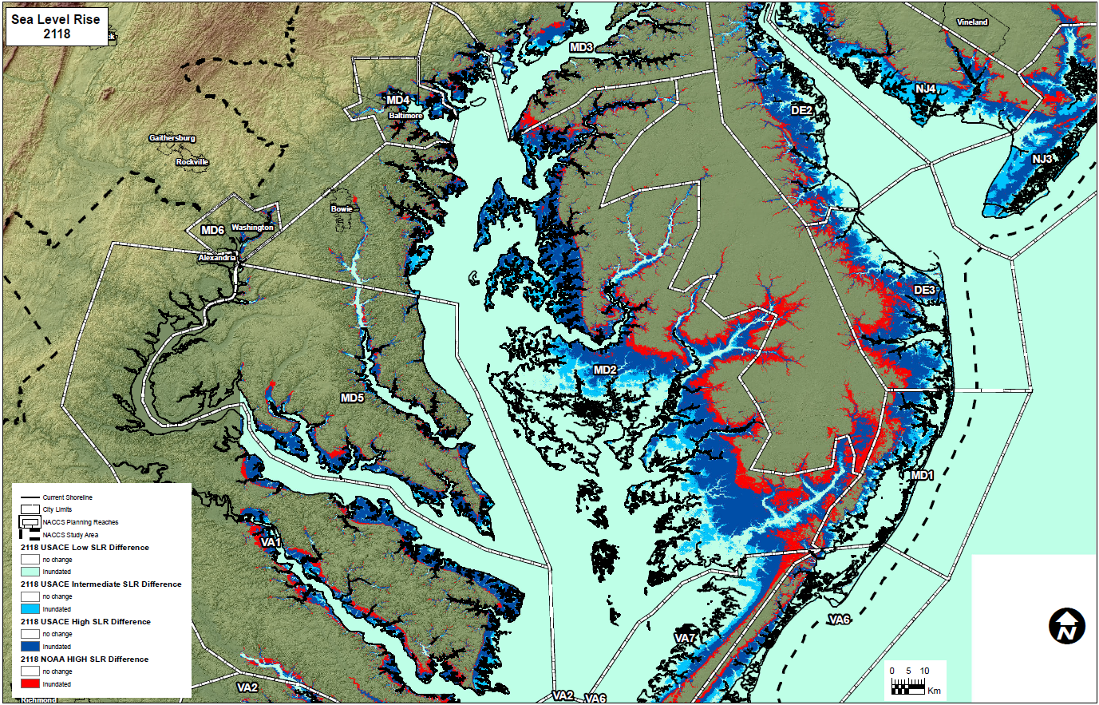
Sea Level Rise Mapping

Slide 16
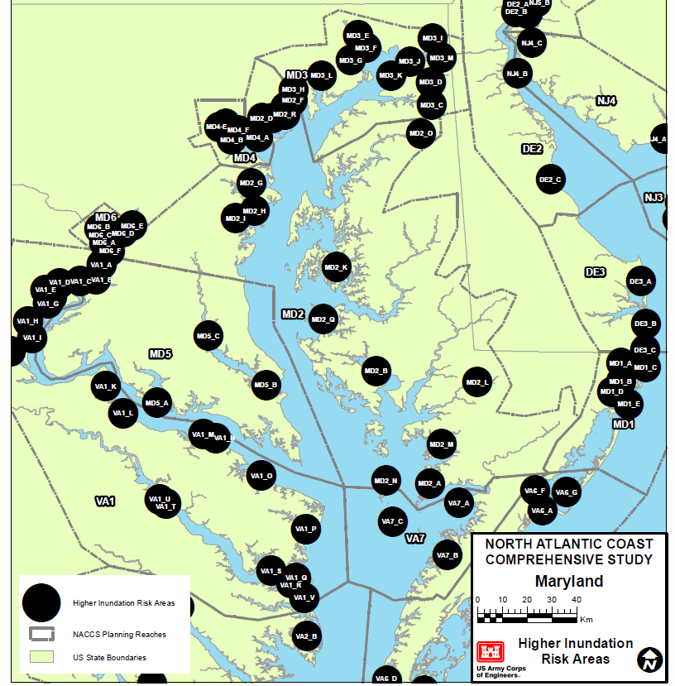
Problem Area Identification

Slide 17
Plan Formulation and GIS Process

Slide 18
Plan Formulation and GIS Process
Develop comprehensive measures list
  Structural – sacrificial
  Structural – non-sacrificial
  Structural – green infrastructure
  Upland Storage/Stormwater Management (includes green infrastructure)
  Floodplain Restoration/Storage
  Non-structural
  Policy/Programmatic
Assess appropriateness of measures by shoreline type (i.e., bluff, sandy, back bay, barrier island, etc.)

Slide 19
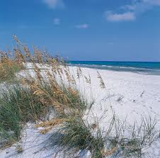
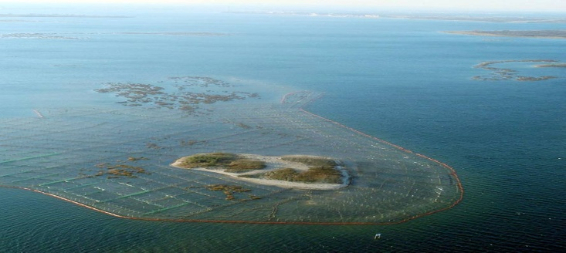
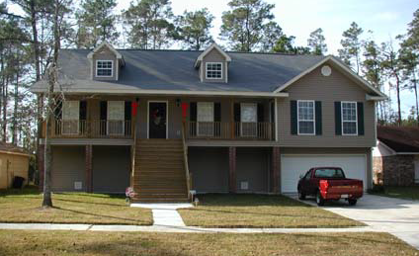
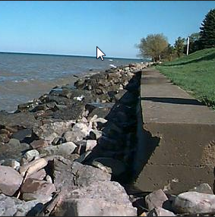
Risk Reduction and Resilience Measures
Measure | Definition | Effect | Examples
Natural | Created through the action of physical, biological, geologic, and chemical processes operating in nature | Shoreline erosion control, wave and surge attenuation, especially in low-energy environments; additional resilience benefits; dynamic behavior and response affect performance with respect to objectives | Barrier islands, dunes, reefs, wetlands, marsh islands and riparian corridors
Nature-Based | Products of planning, engineering design, and construction incorporating natural processes that contribute to coastal risk reduction and resilience | Shoreline erosion control, wave and surge attenuation, especially in low-energy environments; dynamic behavior and response affect performance with respect to objectives
Non-Structural | Products of public policy, management and regulatory practices; may include pricing schemes, planning, engineering design, and construction | Modify or avoid the impacts of the hazard (vs. modifying the hazard); relatively predictable level of performance with respect to objectives | Structure acquisitions or relocations, flood proofing, implementing flood warning systems, flood preparedness planning, land use regulations, development restrictions within the greatest flood hazard areas, elevated development, managed retreat, evacuation, buyout and leaseback
Structural | Products of planning, engineering design, and construction | Shoreline erosion control, wave and surge attenuation, reduced flooding; relatively predictable level of performance with respect to objectives | Levees, storm surge barrier gates, seawalls, groins, revetments, and near-shore breakwaters

Slide 20
Plan Formulation and GIS Process

