Slide 1
North Atlantic Coast Comprehensive Study Natural and Nature-Based Approaches to Support Coastal Resilience and Risk Reduction
Emily Vuxton and Lauren Leuck
U.S. Army Corps of Engineers
Institute for Water Resources (IWR)
Alexandria, VA

Slide 2
Outline
Background and Context on the Authority and Objectives of the North Atlantic Coast Comprehensive Study (NACCS)
Coastal Risk Reduction and Resilience and Natural and Nature-Based Features (NNBF)
The NACCS NNBF Policy Workshop
Findings and Opportunities on NNBF Policy and Institutional Barriers
Questions

Slide 3
Study Authority
Public Law 113-2 directed the U.S. Army Corps of Engineers to:
“conduct a comprehensive study to address the flood risks of vulnerable coastal populations in areas that were affected by Hurricane Sandy within the boundaries of the North Atlantic Division of the Corps… in coordination with other Federal agencies, and State, local and Tribal officials to ensure consistency with other plans to be developed.”

Slide 4
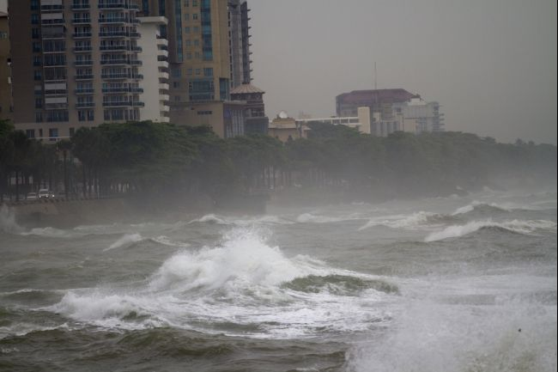
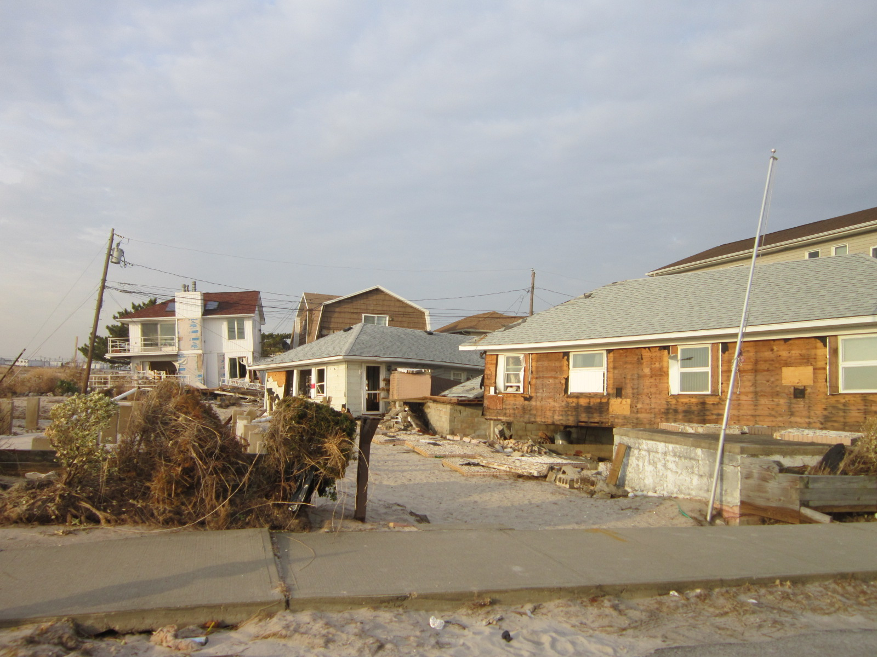
North Atlantic Coast Comprehensive Study
Study due to Congress by January 2015
Ensure study is consistent with interagency efforts
Identify institutional barriers and develop strategies to address them
Notes:
Workshop was major component to identify institutional barriers and develop strategies to address them.

Slide 5
Study Area
Notes:
Intent of study is "Address flood risks of vulnerable coastal populations affected by Hurricane Sandy within North Atlantic Division...”
Coastline as defined by FEMA’s Hurricane Sandy storm surge data
Affected by erosion, precipitation, winds, surge, etc.

Slide 6
Coastal Risk Reduction and Resilience
The USACE planning approach supports an integrated approach to reducing coastal risks and increasing human and ecosystem community resilience through a combination of natural, nature-based, non-structural and structural measures. This approach considers the engineering attributes of the component features and the dependencies and interactions among these features over both the short- and long-term. It also considers the full range of environmental and social benefits produced by the component features.

Slide 7
Notes:
Some examples of NBI and the engineering goals and objectives they are being designed to address

Slide 8
Key Definitions
Natural and Nature-Based Features
Natural features are created and evolve over time through the actions of physical, biological, geologic, and chemical processes operating in nature. Natural coastal features take a variety of forms, including reefs (e.g., coral and oyster), barrier islands, dunes, beaches, wetlands, and maritime forests.
Nature-based features are those that may mimic characteristics of natural features but are created by human design, engineering, and construction to provide specific services such as coastal risk reduction.
The relationships and interactions among the natural and built features comprising the coastal system are important variables determining coastal vulnerability, reliability, risk, and resilience.

Slide 9
“Policy Challenges to Using Nature-Based and Green Coastal Features for Risk Reduction and Resiliency” Workshop
November 20th, 2013 at USACE IWR in Alexandria, VA
34 participants
Breakout groups and plenary sessions generated discussion and input

Slide 10
Questions from Policy Workshop
Question #1: What do you believe are the most significant policy challenges related to the implementation of NNBF? What changes in existing policy would have the greatest positive influence on the implementation of NNBF?
Question #2: What actions could be taken to improve the coordination needed among federal, state and local agencies in order to implement NNBF? What actions could be taken within your own organization to expand opportunities for the implementation of NNBF?
Question #3: What uncertainties or information gaps impede decision making for NNBF projects? How can progress be made on implementing NNBF in view of these uncertainties? How do existing policies support or impede the application of adaptive management to NNBF projects?
Question #4: How can communication across the organizations interested in NNBF (including governmental and non-governmental organizations) be improved?

Slide 11
Key findings and opportunities

Slide 12
Science, Engineering, and Technology
Knowledge and Data Deficiencies on NNBF
Performance
Timing
Scale
Lifecycle costs to operate and maintain
Effects of sea level rise and climate change
Policies and resources are needed to address these deficiencies.

Slide 13
Science, Engineering, and Technology
Ecosystem Goods and Services (EGS)
The kinds of EGS and the extent of EGS provided by different NNBF solutions are generally poorly understood.
Need means to perform full valuations of the complete range of EGS provided by NNBF.
Policies to inform cost-benefit valuations of the EGS provided by NNBF are needed for project prioritization and agency budgeting.
There is a need for policies regarding the use of non-monetized benefits and direction on how to monetize benefits provided by NNBF.

Slide 14
Science, Engineering, and Technology
Adaptive Management
Many federal agencies lack funding or clear mandates to conduct adaptive management.
Adaptive management is also impeded by existing consultation processes and NEPA requirements which can prohibit responsive adaptive management.
Existing policies hamper the application of adaptive management in municipalities.

Slide 15
Science, Engineering, and Technology
Opportunities
NNBF demonstration projects are needed.
Need to develop case studies, best practices, and guidance documents on NNBF.
Create risk and resiliency performance metrics for NNBF to consider processes and outputs across a range of scales, including at the scale of the overall system.
There is also the need and opportunity to more effectively and transparently share information between the government, stakeholders, and general public about NNBF.
Notes:
NNBF demonstration projects are needed to provide opportunities for experimentation and to learn the best practices and uses of NNBF and resolve some of the uncertainties.
Development of case studies, best practices, and guidance documents are needed to demonstrate what types of EGS can be expected from NNBF and quantify their value.
It is important to create risk and resiliency performance metrics for NNBF to consider processes and outputs across a range of scales, including at the scale of the overall system.
There is also the need and opportunity to more effectively and transparently share information between the government, stakeholders, and general public about NNBF. This could be helped with a wiki-type repository of knowledge adjacent to a data portal which could include contact information of people involved in NNBF efforts in different organizations and agencies.

Slide 16
Leadership and Institutional Coordination
Land use planning and zoning policies often do not encourage, and can limit the use of NNBF.
All USACE flood and coastal storm damage reduction projects require a cost sharing partner, but aligning budgets and schedules for cost-sharing partnerships is an ongoing challenge.
Local agency planning timelines and federal agency permitting timelines are often misaligned.
Projects are often regulated on a “case by case” basis but the development of programmatic, regional, landscape, or system focused projects could increase efficiencies in permitting.
There is a need for policies that support efficient coordination and decision making for NNBF projects that could impact wetlands, threatened and endangered species, or essential fish habitat.

Slide 17
Leadership and Institutional Coordination
Emergency Response
Some authorities restrict what can be built using emergency funds. Potential changes to these policies should be discussed.
Aid provided after emergencies should be delivered in a strategic way by implementing updated and more resilient solutions, including NNBF, as opposed to rebuilding to pre-disaster conditions.
A gap in coordination between the emergency response, recovery, and mitigation communities is currently present that could be addressed to encourage the implementation of more resilient solutions following a disaster.

Slide 18
Leadership and Institutional Coordination
Opportunities
Improve regional coordination through existing mechanisms such as Silver Jackets, NOAA Sea Grant and USDA extension offices.
Utilize public/private partnerships to implement NNBF.
Initiate the development of guidance and policies to achieve robust coordination and data sharing among resource and planning agencies.
Incorporate NNBF into existing decision support and communication tools.
Leverage partnerships and funding to promote NNBF in support of community resilience.
Develop a guidebook with information on NNBF that could be implemented during the process following a disaster.

Slide 19
Communication and Outreach
Develop common definitions for NNBF.
A greater understanding of the costs and benefits of NNBF is needed to be able to compare these features to more traditional structural methods.
Communication needs to be improved at multiple levels including between and within Federal, state, and local levels of government.
Outreach and communication should target private interests and homeowners who determine the types of projects to implement on their land.
Notes:
Common definitions for NNBF should be developed that would enable interested parties to communicate more effectively about these features.
A greater understanding of the costs and benefits of NNBF is needed, particularly on how these features can increase the resilience of a community, ecosystem, or local economy.
Clear and concise language about the benefits of NNBF is needed to be able to compare these features to the more traditional structural methods that have been implemented in the past.
Communication needs to be improved at multiple levels including between and within Federal, state, and local levels of government. Outreach and communication should also target private interests and homeowners who determine the types of projects to implement on their land.

Slide 20
Communication and Outreach
Opportunities
Develop a policy digest with relevant definitions of NNBF, as well as the authorities, roles and responsibilities of Federal, state and local agencies that have jurisdiction or interest in the implementation of NNBF.
Form a NNBF community of practice.
Develop guidance and tools for private interests and landowners with information on the use, implementation and performance of NNBF.

Slide 21
Questions?
Emily Vuxton
Emily.A.Vuxton@usace.army.mil
Lauren Leuck
Lauren.Leuck@usace.army.mil

