Slide 1
North Atlantic Coast Comprehensive Study: Policy Challenges and Institutional Barriers Overview
Mark Dunning, Ph.D.
CDM Smith
Fairfax, VA

Slide 2
Agenda
General NACCS overview
Part 1: Policy and institutional challenges as identified by interviews/literature review
Part 2: Workshop on policy challenges for nature-based infrastructure

Slide 3
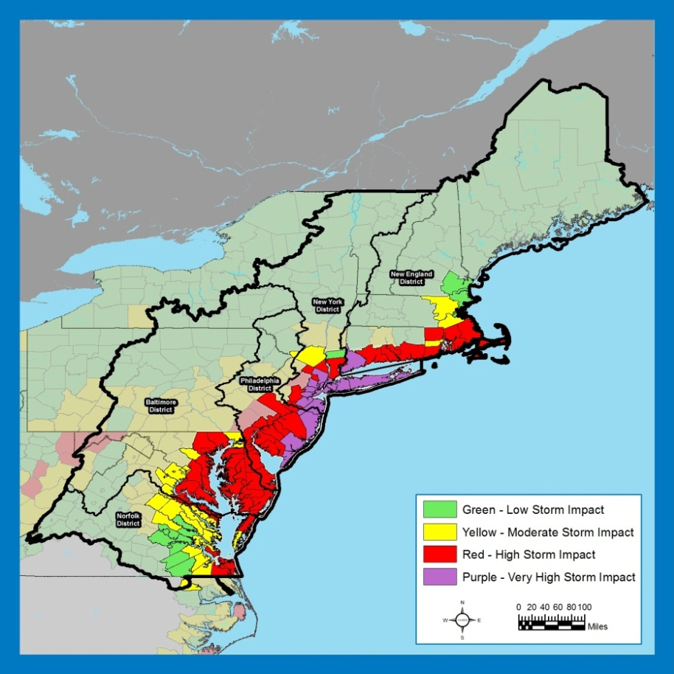
NACCS Background
“That using up to $20,000,000* of the funds provided herein, the Secretary shall conduct a comprehensive study to address the flood risks of vulnerable coastal populations in areas that were affected by Hurricane Sandy within the boundaries of the North Atlantic Division of the Corps…” (*$19M after sequestration)
Complete by Jan 2015
Goals
Provide a risk reduction framework, consistent with USACE-NOAA Rebuilding Principles
Support resilient coastal communities and robust, sustainable coastal landscape systems, considering future sea level rise and climate change scenarios, to reduce risk to vulnerable population, property, ecosystems, and infrastructure
Notes:
Areas affected by erosion, precipitation, winds, surge, etc. (FEMA’s H. Sandy storm surge data)

Slide 4
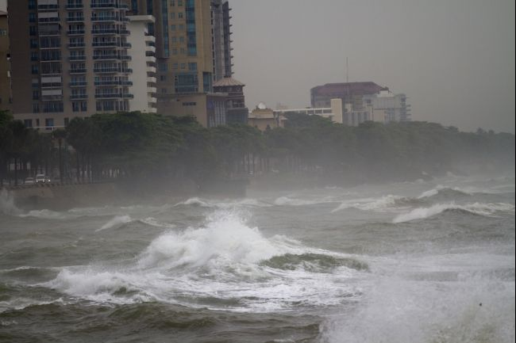
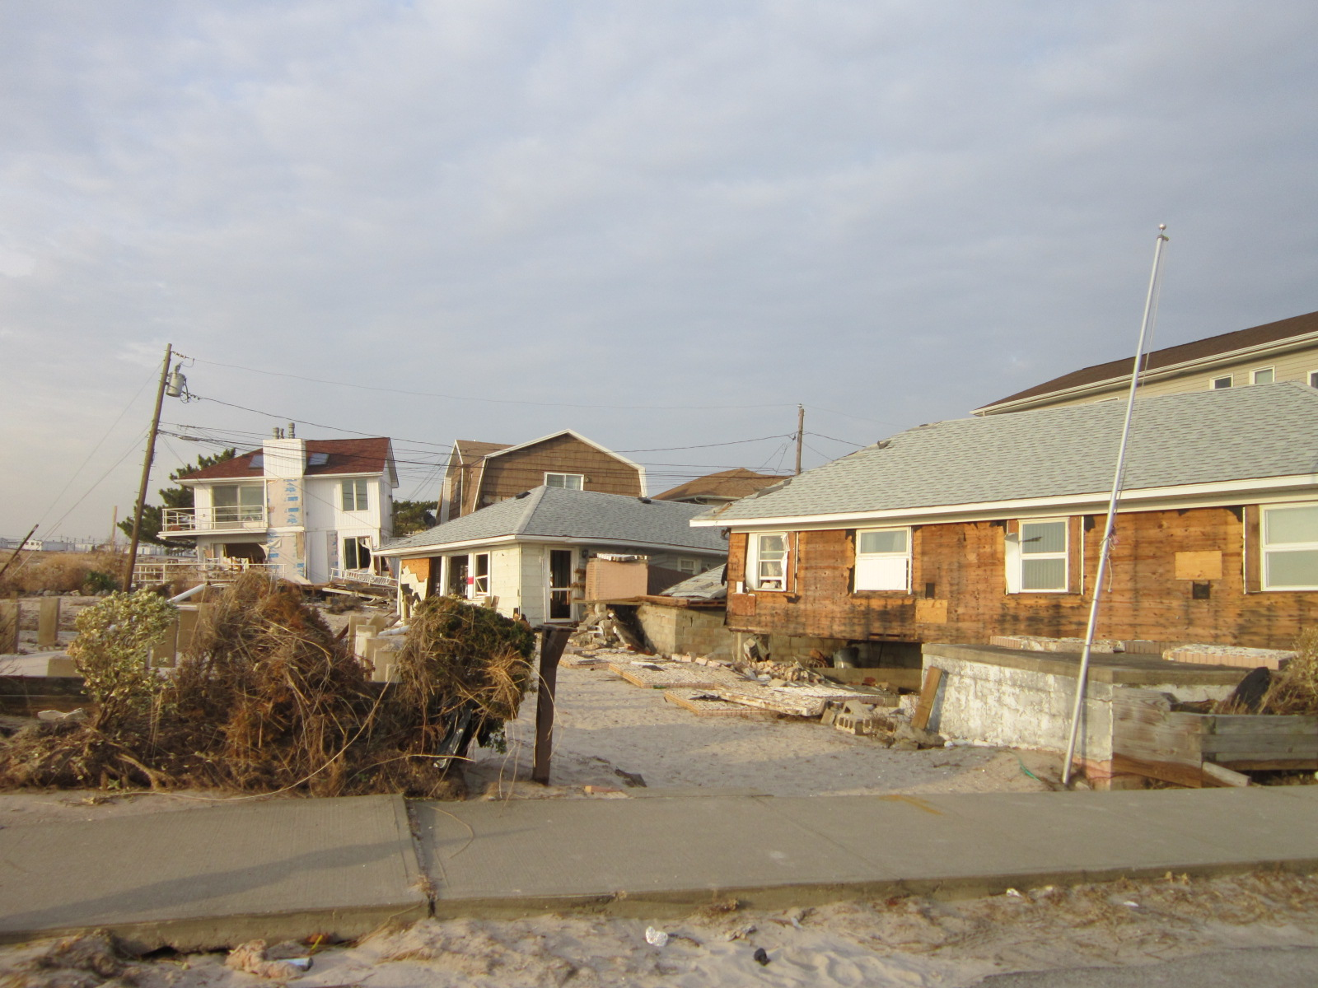
North Atlantic Coast Comprehensive Study
Study due to Congress by January 2015
Ensure study is consistent with interagency efforts
Identify institutional barriers and develop strategies to address them
Notes:
Workshop was major component to identify institutional barriers and develop strategies to address them.

Slide 5
Part 1: Objective
Identify “Policy Challenges” that, in the broadest sense, hinder the ability to provide comprehensive protection to coastal areas. “Policy Challenges” include:
Policies (laws, regulations, agency guidance and programs) at federal, state, or local levels that:
Contribute to vulnerability of coastal populations, and/or to vulnerability of coastal infrastructure
Work at cross purposes with policies and measures that reduce risk and/or increase resiliency
Increase flood risk in the coastal zone (tidally influenced)
Conflict with the goals of coastal management
Expose federal investments or increase financial exposure of Federal taxpayers
Institutional barriers posed by agency silos, missions, incompatible policies, etc. that:
Inhibit necessary coordination and collaboration among agencies/levels of government, and/or that otherwise impede the attainment of NACCS goals
Public/political barriers that impede a community’s or politician’s willingness to support hard decisions, innovative solutions or change

Slide 6
Part 1: Key Questions & Approach
Key Questions
What are the most significant policy challenges that complicate or impede the attainment of NACCS goals? (Challenges)
What policies are facilitating the attainment of NACCS goals? (Successes)
What are priorities for action for tackling policy challenges? (Opportunities)
Approach
Interviews (federal, state, local government representatives, academe, stakeholder groups)
Literature reviews

Slide 7
Part 1: Bottom Line Up Front
Policy landscape is complex and vast
This landscape is becoming more supportive of NACCS risk management and resilience goals
Numerous ideas and recommendations for creating a policy environment more supportive of NACCS goals have emerged during the NACCS study
Some of the more significant findings are presented in today’s webinar

Slide 8
Findings: Challenges, Successes, Opportunities
Themes
Risk/resilience standards
Risk communication and outreach
Risk management
Science, engineering, and technology
Leadership and institutional coordination
Economic stressors and resources

Slide 9
Risk/Resilience Standards
Challenges
Lack of a uniform standard for defining “acceptable risk” for coastal communities and infrastructure.
Some federal policies’ disaster mitigation requirements prevent risk management improvements
Successes
Hurricane Sandy Rebuilding Strategy Task Force (HSRSTF) recommended a minimum flood risk reduction rebuilding standard for major federal investments of (ABFE+1)
Opportunities
Develop standards for acceptable risk
Assemble team of federal leaders, governors, and regional/ local champions for resilience to develop a national strategy for risk reduction and resilience, and to harmonize and untangle federal risk management policies that work at cross purposes

Slide 10
Risk Communication and Outreach
Challenges
Effective communication of risk is difficult and sometimes key messages about risk are ignored, misunderstood, or overshadowed by fear of economic consequences associated with risk management options.
Successes
Sea Grant program, EPA National Estuary Program, local “listening sessions”
Opportunities
Improved risk communication tools

Slide 11
Risk Management
Challenges
Complexity of risk management programs and policies provided by myriad agencies, and their sometimes inconsistent and/or conflicting execution at the local level has frustrated the recovery process and sometimes resulted in lost opportunities
Lack of local level resilience planning capacity and capability
Regulatory process sometimes constrains risk management solutions
Rising insurance rates and flood risk maps
Successes
FEMA Community Rating System incentivizes floodplain management BMPs
Opportunities
Create a safety net for low income flood insurance policy holders
Explore public – private partnership opportunities for regional sediment management
Explore developing general permit conditions that support broad range of risk management solutions in the general permit process

Slide 12
Science, Engineering, and Technology
Challenges
USACE dredge material disposal policy “least cost” requirement (Federal Standard) misses opportunities for beach nourishment
Little performance and engineering information regarding “nature based” or “green infrastructure” coastal management solutions comparable to that available for hardened structures
Successes
NOAA/USACE map services; USACE/NOAA/FEMA SAGE initiative
Opportunities
Re-evaluate the Federal Standard for possibility of broadening evaluation factors beyond economic least cost to include ecosystem service benefits/costs, public safety, and other factors addressed in the new Principles and Requirements
Develop design guidance for coastal risk reduction nature-based/ green infrastructure solutions; information on O&M requirements

Slide 13
Leadership and Institutional Coordination
Challenges
Lack of/limited coordination across Congressional committees
Lack or limited coordination among/within agencies and levels of government
Successes
Move for new WRDA; formation of the MitFLG; FIFMTF
Opportunities
Explore use of existing coordinating/integrating mechanisms like River Basin Commissions for coastal decision making
Explore developing special authorization (with a sunset provision) for the Sandy area to harmonize agency policies and address agency silo challenges that conflict with overarching Sandy recovery goals.
Perhaps, in combination with special authorization opportunity above, explore developing interagency pilot project(s) to develop innovative risk management and resiliency solutions

Slide 14
Economic Stressors and Resources
Challenges
Authorities focused on least cost or BCR limiting ability to consider other benefits; often not conducive to regional/watershed solutions
Diverse cost sharing rules and policies complicate innovative financing and partnerships
Investments to prepare for and mitigate future disasters provides much higher return than investments in disaster recovery
Successes
Authorization of funds through Disaster Relief Appropriations; growing support for public-private partnerships; new Principles and Requirements
Opportunities
Create new tax and market-based incentive programs for risk management and resilience
New tools for quantifying benefits identified in the P&R

Slide 15
Part 1: Summary, Conclusions
A policy and institutional landscape more supportive of NACCS goals is emerging
Some key opportunities for creating a policy environment more supportive of NACCS goals:
Standards to define acceptable levels of risks
Integrated national/regional strategies for flood risk and coastal management
Strong coordinated leadership/governance to tackle institutional barriers and promote interagency collaboration
Improved tools for communicating risk
Disaster mitigation funding (vs. disaster recovery)

Slide 16
Part 1: Questions?
Mark Dunning
Dunningcm@cdmsmith.com
703-691-6500

