Slide 1
North Atlantic Coast
Comprehensive Study
Collaboration Webinar Series #5: Policy Challenges and Institutional Barriers
U.S. Army Corps of Engineers
Coastal Storm Risk Management
Planning Center of Expertise
19 December 2013

Slide 2
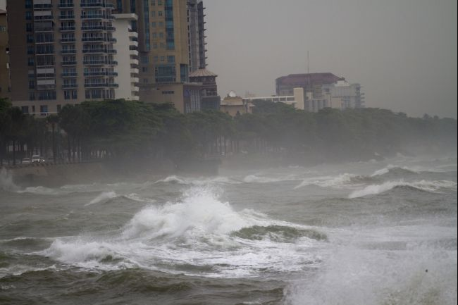
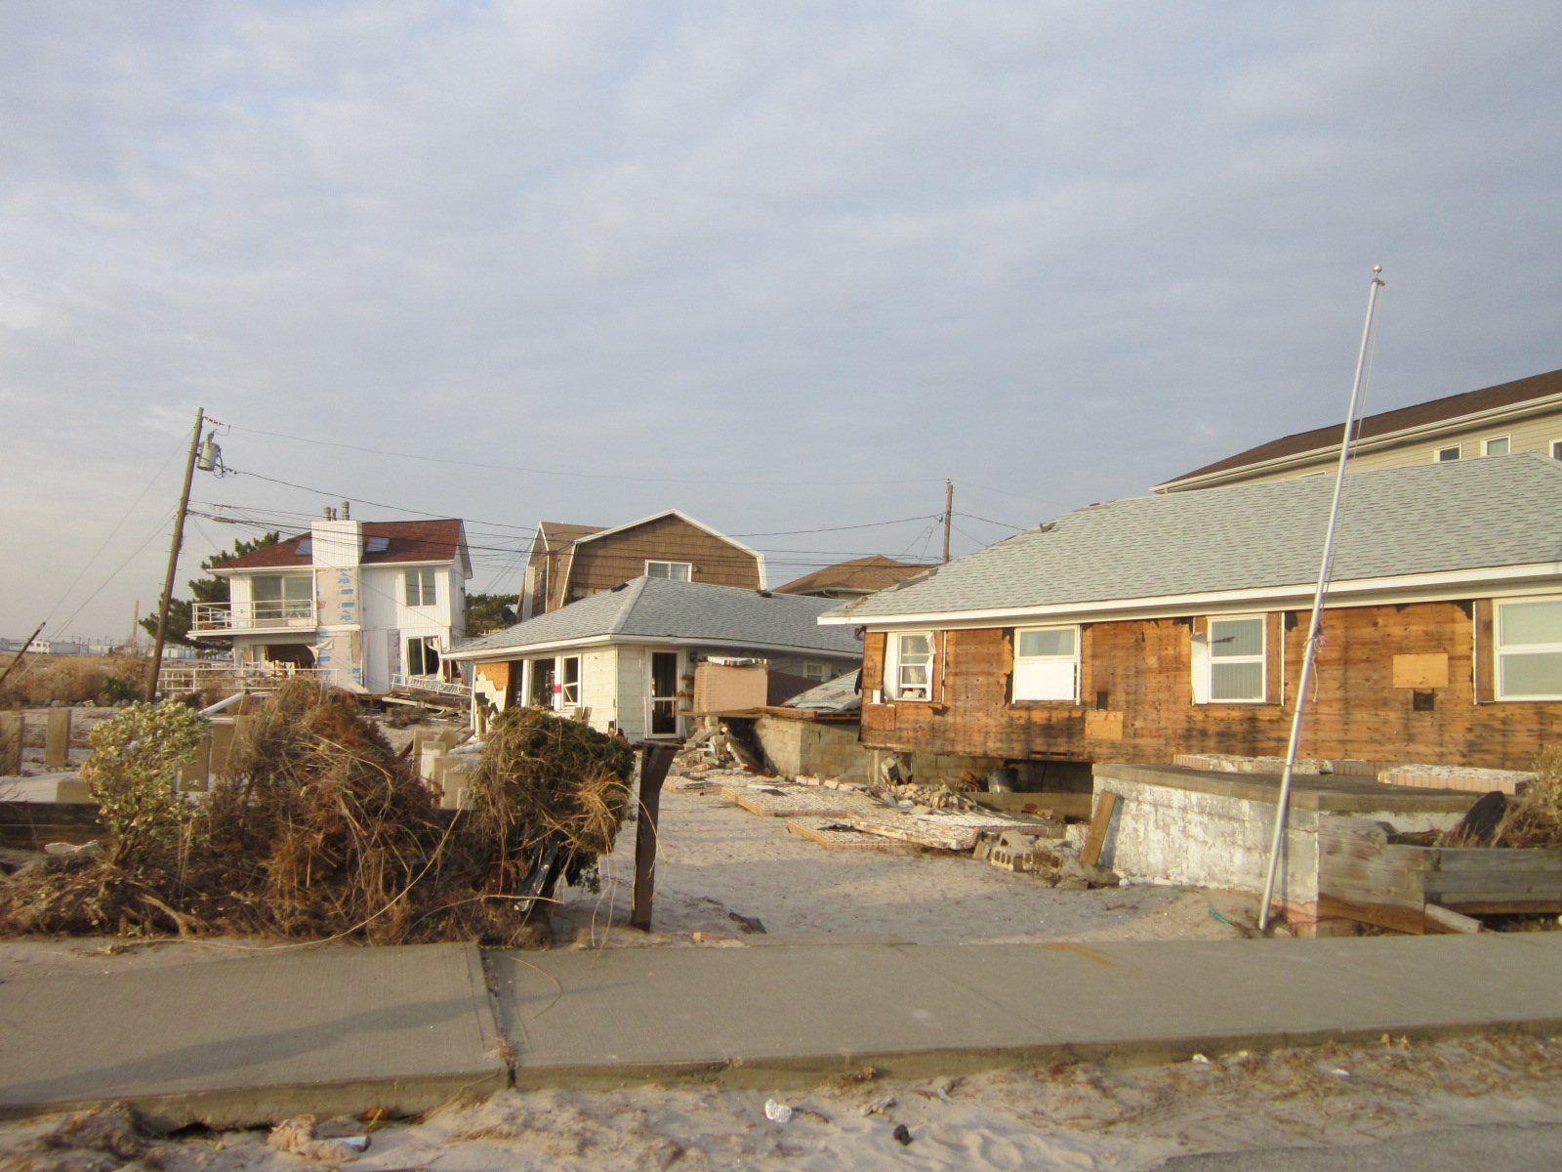
Overview
Hurricane Sandy impacted the Atlantic coastline in October 2012
Affected entire east coast:
24 States from Florida to Maine; New Jersey to Michigan and Wisconsin
Greatest areas of impact: New Jersey, New York, Connecticut
Public Law 113-2 enacted
January 29, 2013

Slide 3
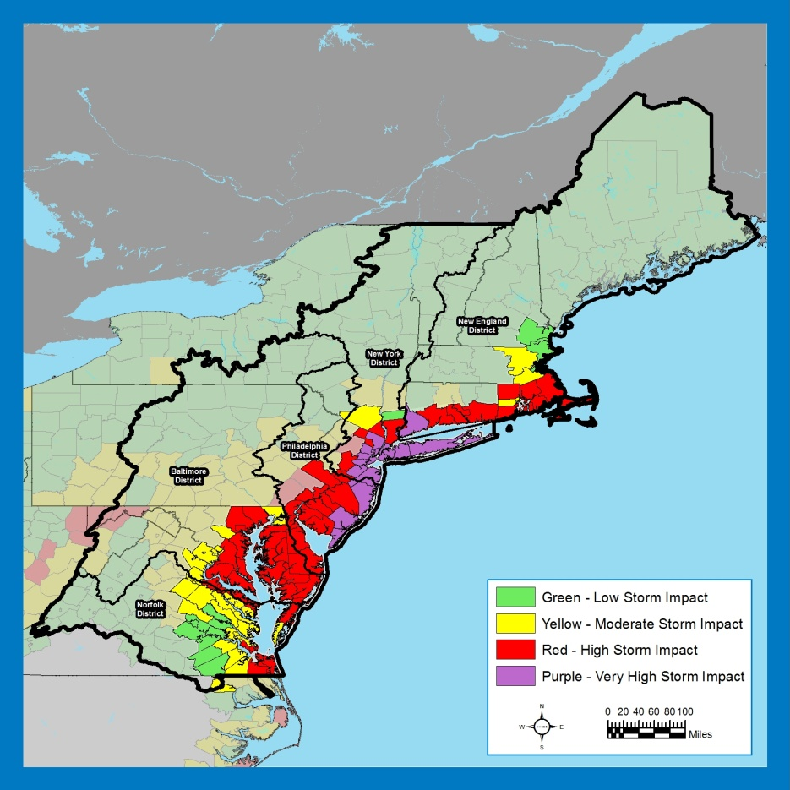
Background
“That using up to $20,000,000* of the funds provided herein, the Secretary shall conduct a comprehensive study to address the flood risks of vulnerable coastal populations in areas that were affected by Hurricane Sandy within the boundaries of the North Atlantic Division of the Corps…” (*$19M after sequestration)
Complete by Jan 2015
  Goals:
Provide a Risk Reduction Framework , consistent with
USACE-NOAA Rebuilding Principles
Support Resilient Coastal Communities and robust, sustainable coastal landscape systems, considering future sea level rise and climate change scenarios, to reduce risk to vulnerable population, property, ecosystems, and infrastructure.
Notes:
Areas affected by erosion, precipitation, winds, surge, etc. (FEMA’s H. Sandy storm surge data)

Slide 4
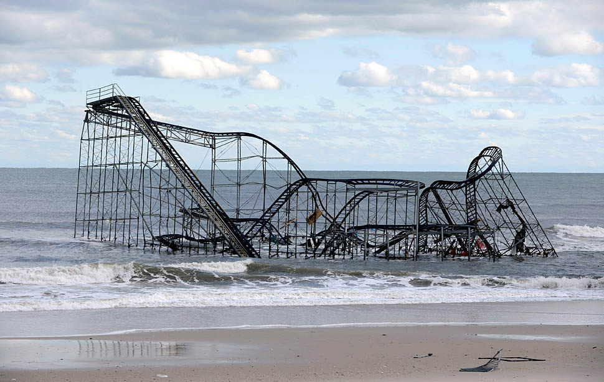
Technical Teams
USACE Enterprise
Agency Subject Matter Experts
  Engineering
  Economics
  Environmental, Cultural, and
  Social
  Sea Level and Climate Change
  Plan Formulation
  Coastal GIS Analysis
Products
Coastal Framework
  Regional scale
  Collaborative
  Opportunities by region/state
  Identify range of potential solutions and parametric costs by region/state
  Identify activities warranting additional analysis and social/institutional barriers
Not a Decision Document
  No NEPA
  No Recommendations

