Slide 1
North Atlantic Coast Comprehensive Study Collaboration Webinar Series #2: Ecosystem Goods and Services
U.S. Army Corps of Engineers
Coastal Storm Risk Management
Planning Center of Expertise
29 August 2013

Slide 2
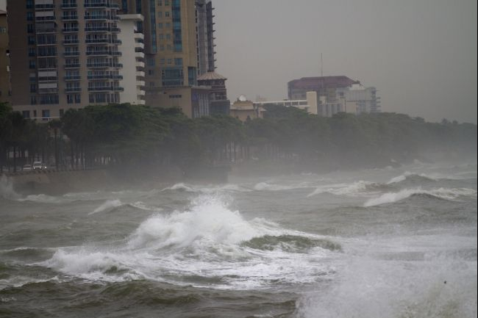
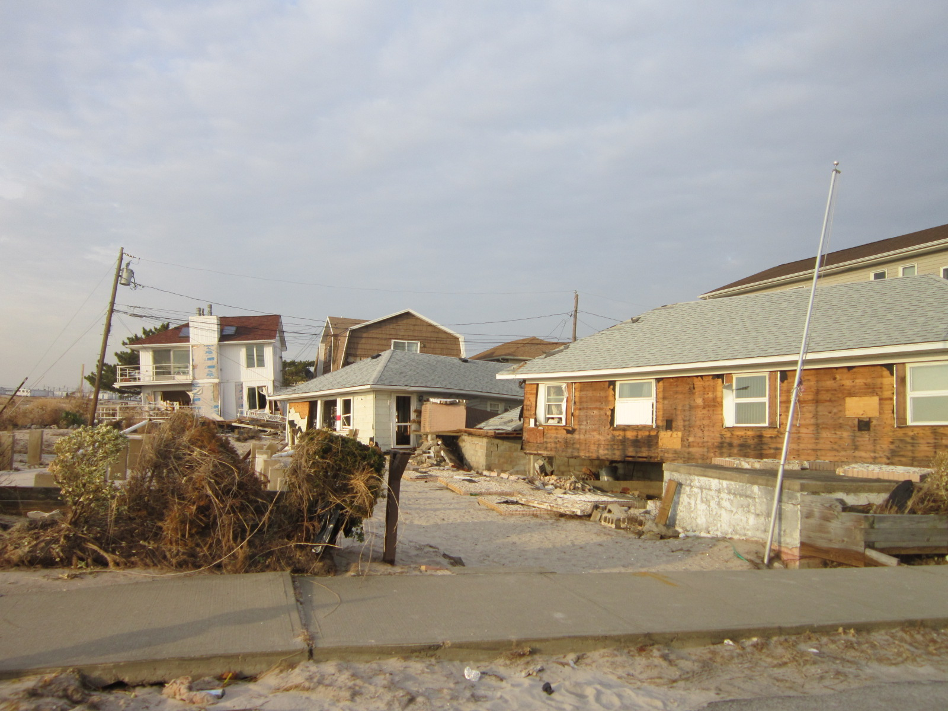
Overview
Hurricane Sandy impacted the Atlantic coastline in October 2012
Affected entire east coast:
24 States from Florida to Maine; New Jersey to Michigan and Wisconsin
Greatest areas of impact: New Jersey, New York, Connecticut
Public Law 113-2 enacted
January 29, 2013

Slide 3
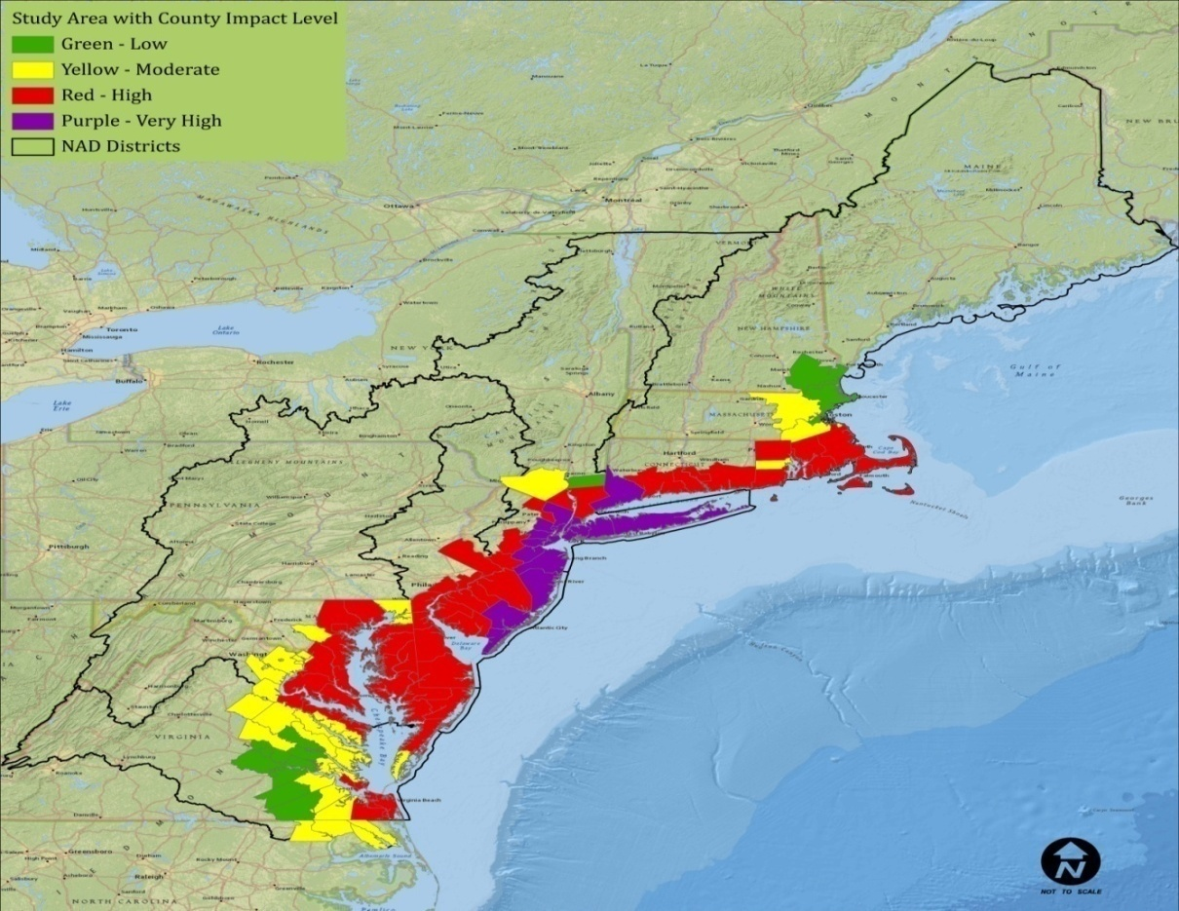
North Atlantic Coast Comprehensive Study
“That using up to $20,000,000* of the funds provided herein, the Secretary shall conduct
comprehensive study to address the flood risks of vulnerable coastal populations in
areas that were affected by Hurricane Sandy within the boundaries of the North Atlantic
Division of the Corps…” (*$19M after sequestration)
Comprehensive Study to be complete
by Jan 2015
Areas affected by erosion, precipitation, winds, surge, etc. (FEMA’s H. Sandy storm surge data)
Goals:
Provide a Risk Reduction Framework *Consistent with USACE-NOAA Infrastructure Systems Rebuilding Principles 28 Feb 2013
Support Coastal Resilient Communities and sustainable coastal landscape systems, considering future sea level rise and climate change scenarios, to reduce risk to vulnerable population, property, ecosystems, and infrastructure.

Slide 4
Technical Teams
USACE Enterprise
Agency Subject Matter Experts
Engineering
Economics
Environmental, Cultural, and
Social
Sea Level and Climate Change
Plan Formulation
Coastal GIS Analysis
Products
Coastal Framework
Regional scale
Collaborative
Opportunities by region/state
Identify range of potential solutions and parametric costs by region/state
Identify activities warranting additional analysis and social/institutional barriers
Not a Decision Document
No NEPA
No Recommendations

